Slide 1
Multi-cloud Orchestration with Terraform

Slide 2
US National CSA Team
Vandy Rodrigues
Cenk Caglar

Slide 3
Multi-cloud Strategy - Challenges
Business Strategy
Technical Challenges
Why a multi-cloud Strategy?
Regulation
Cost Savings
Resilience
Cloud Agnostic
Uncertainties and Concerns
Complexity
Operations
Tooling
Training
Skill Set
Technical Aspects
Infrastructure
Identity
Networking
Security
Governance
Automation
Application Discovery
Decommission
Re-platform
Redesign
Rearchitect
Where to deploy?
Notes:
Identify the customer’s stage / maturity
Is the customer already using Azure or other Cloud providers
Investing in serverless / deploying
Cloud agnostic

Slide 4
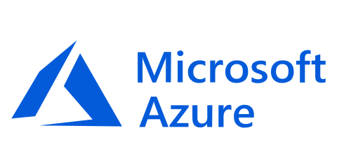
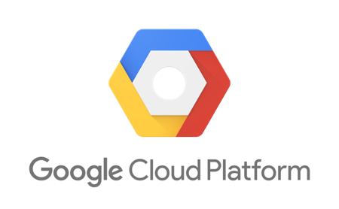
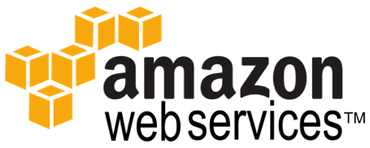



Terraform Ecosystem
Terraform Ecosystem
Partnerships with 45+ technology providers, community support for many more
Version-control Systems
Infrastructure providers
Core
Provider
List of all 70+ providers www.terraform.io/docs/providers/
Notes:
Partnerships
VCS support

Slide 5
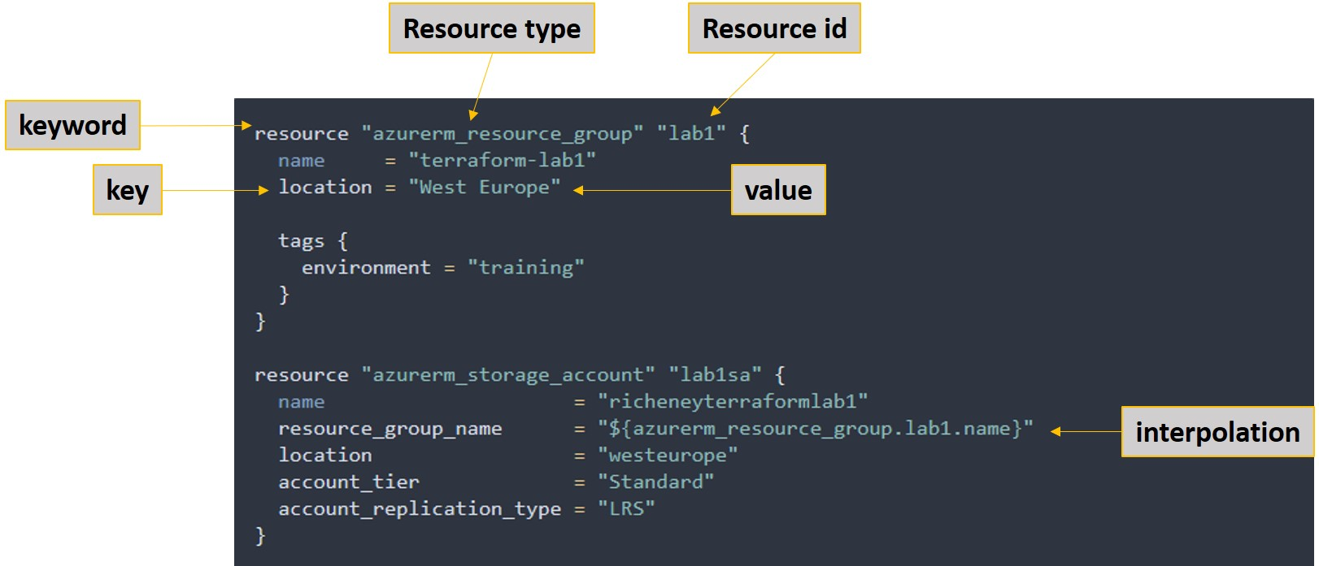
Terraform basics

Slide 6
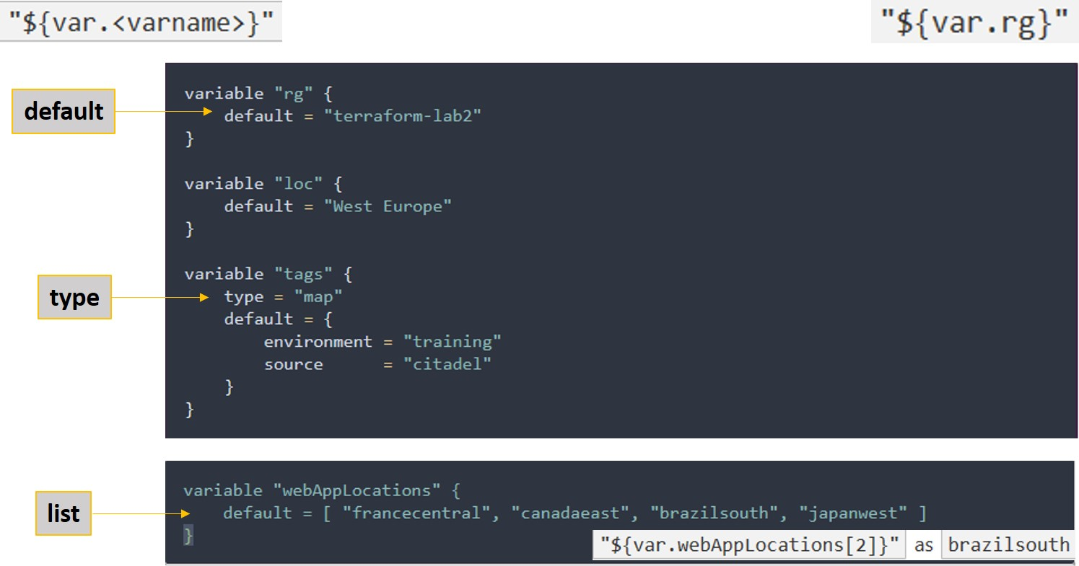
Terraform variables
Notes:
Terraform Labs: https://azurecitadel.github.io/workshops/terraform/#labs
Azure CLI: https://docs.microsoft.com/en-us/cli/azure/get-started-with-azure-cli?view=azure-cli-latest

Slide 7
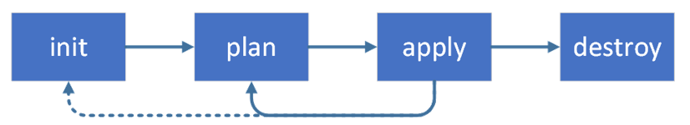
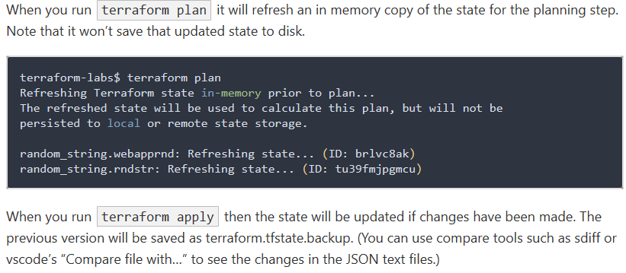
Terraform workflow
terraform init
terraform plan
terraform apply
terraform destroy

Slide 8
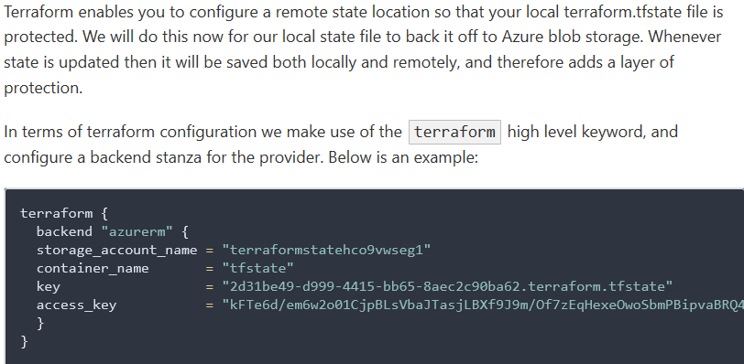
Terraform remote state

Slide 9
Prerequisites for the labs
Azure subscription (with ‘contributor rights’), or an Azure Pass or free account.
Terraform Open Source
Windows or a Linux machine
💬 Note. If you are using an Azure Free Pass then please do not activate it using your work email address. If you do then it will be unlikely that you will have RBAC permissions to create Service Principals and you will be limited to using the Azure CLI authentication.

Slide 10
Workshops
Workshop 1
Workshop 3
Workshop 2
Demo
Deploying Infrastructure as Code – Workshop 1
Azure RG, VM, Manage Disk and VNET, NSG.
Deploying Azure PaaS – Workshop 2
Azure Web App Multi-region, Azure SQL DB, NLB
Deploy Azure Kubernetes Services (AKS) – Workshop 3
Terraform Enterprise - Demo
https://github.com/cenkms/MultiCloudStarter

Slide 11
Workshop 1: Scenario IaaS
Azure VM
https://github.com/cenkms/MultiCloudStarter/tree/master/workshops/workshop1

Slide 12
Workshop 2: Scenario PaaS
Azure Web App Multi-Region
https://github.com/cenkms/MultiCloudStarter/tree/master/workshops/workshop2

Slide 13
References
Microsoft cloud IT architecture resources
Azure Reference Architectures
Azure Virtual Datacenter and the Enterprise Control Plane
Microsoft Cloud Adoption Framework for Azure
Azure subscription and service limits, quotas, and constraints
Terraform on Azure - Labs

Slide 14
Multi-cloud Orchestration with Terraform
Thank you!

